Slide 1

Methodological Design
V-model coffeemaker
Jan Bollen

Slide 2

Agenda
Projects
Methodological design
Stakeholders
V model
Project Setup
System Requirements
Functional Design
Technical Design
Testing
Deliverables

Slide 3
Projects, examples
  Building a bridge
  Developing a new product
  Developing a marketing plan
  Reducing waiting lists at hospitals
  Doing a theater production
  Conducting research for a thesis
  Organizing a pop festival
  Implementing software at a company
  Setting up a website
  ……..

Slide 4
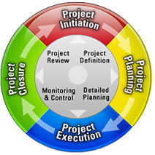
Managing a Project
Project Life Cycle
Initiation
Planning
Execution
Closure

Slide 5
Activities / Coffeemaker
Execution of the project
Research
/ know all the details of the original coffee maker machine
Designing
/ How will the new machine work and look like
Realising
/ Producing the new machine
Testing
/ Does it work yes or no?
/ Is the Client and User satisfied?

Slide 6

Principles of methodological design
Think first, then act!
Think through project in detail
  from start to finish AND
  from finish to start.
Work from global to detail
  Top-down working
  First the big picture
  Then the details!

Slide 7
Methodological Design
Objectives
Minimization of Project Risks
Improvement and Guarantee of Quality
Reduction of Total Cost over the entire project
Improvement of communication between all Stakeholders

Slide 8

Stakeholders
Operator
Manufacturer
Seller
Transporter
Maintainer
Dismantler

Slide 9

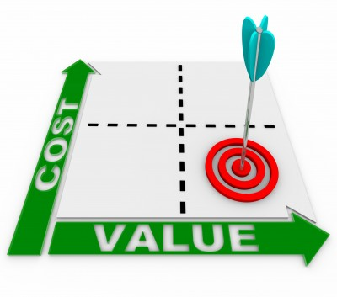
Costs
Chairman € 90 per hour
Secretary € 40 per hour
Designer € 60 per hour

Slide 10
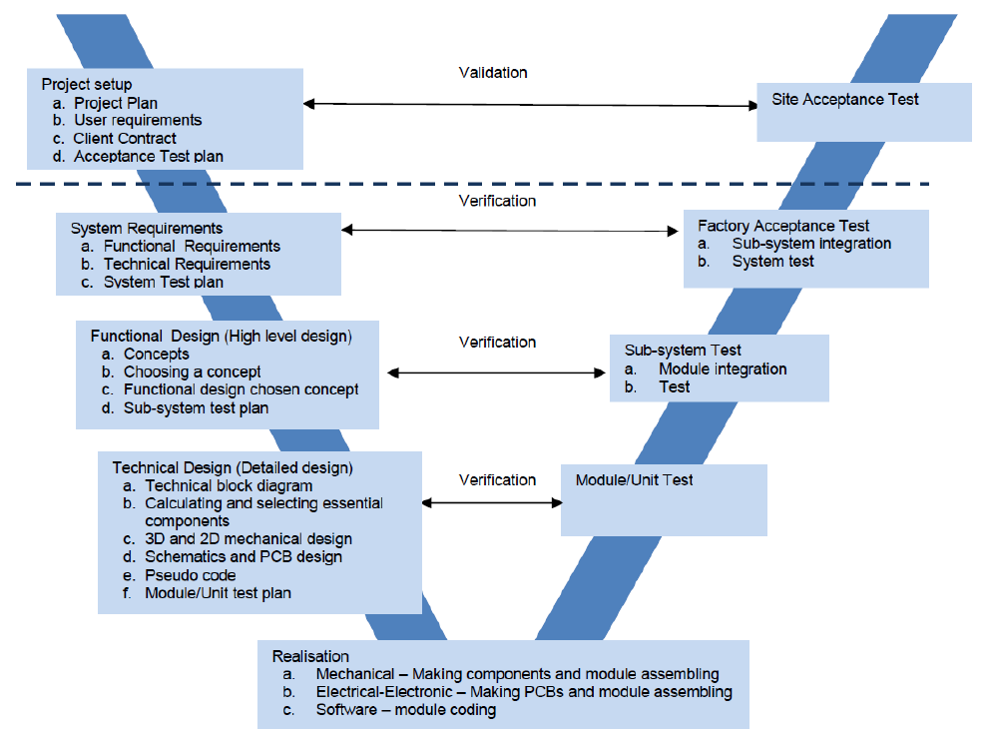

V-model

Slide 11
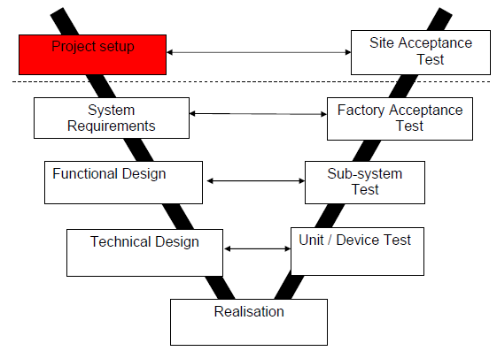
Project setup
User Requirements
  Description of the system as expected by the client Saxion
Project Plan
  Document for managing the project
  Use the format of Roel Gritt !!!
Site Acceptance Test (SAT)
  Demonstration of working model of the modified coffeemaker machine.

Slide 12
Project setup
Project Plan
Background info | Where (in what environment) will the project be carried out?
Project results | Why carry out this project and what is the desired final result?
Project activities | What do we need to do to achieve the project goal?
Project limits | What are the boundaries of the project?
The products | What are the intermediate products?
Quality control | How can we ensure the sufficient quality of all products?
Project organization | Who is participating and how do we plan to collaborate?
Schedule | Who is doing what / when?
Costs and benefits | What will the project cost and what will it yield?
Risks | What could cause the project to fail?

Slide 13
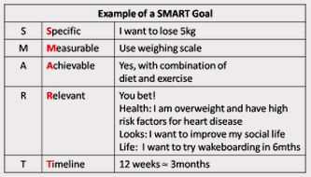
Project setup, SMART results
  S – Specific
  M – Measurable
  A – Acceptable
  R – Realistic
  T – Time
  bound

Slide 14
Project limits
Start of project
Start date
Project
Boundaries
Activity
Activity
Project boundaries must
be specific!
End of project
End date

Slide 15
Project Organization
Main functions in a project organization:
Project leader
Secretary / documentation
Technical designer 1
Technical designer 2
Each function should be described:
Tasks
Responsibilities

Slide 16
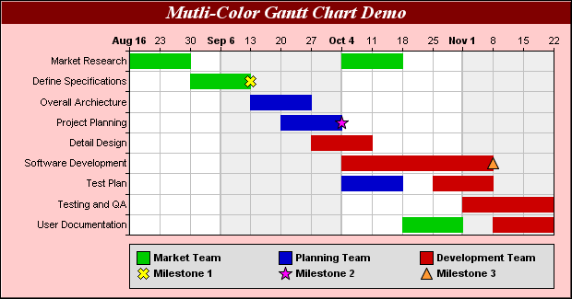
Schedule, Gantt Chart
Software: Microsoft Projects GanttProject
Activities
Tasks
Milestones
Legenda
per person

Slide 17
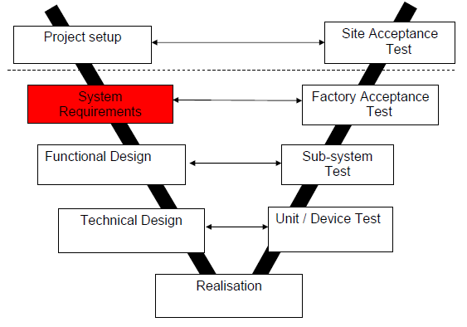
System requirements
First some questions
should be answered:
Investigate coffee making
Research original machine
Temperature measurements original machine
Conclusions of temperature control original machine
System requirements:
Specifications temperature range new machine

Slide 18
System requirements
Some other questions:
Who is the target group
of clients?
What will the clients pay for the machine?
Is the speed of coffee making important?
What is a normal drinking coffee temperature?
What is the maximum coffee temperature?
For how many cups is the coffee machine?

Slide 19
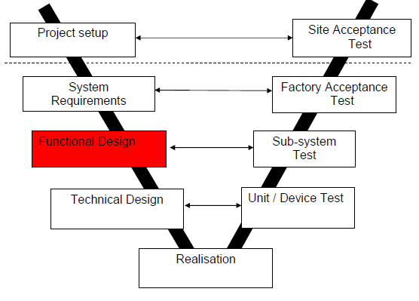
Functional Design
What does the client get?
How can the user operate
the new machine?
Concept principles (morphological)
  Electrical block diagram: What temperature sensor? / How to do signal process? / What control concept? / Which power stage?
  Mechanical: New construction of chassis / Which material? / How to assemble?
Functional design go / no go

Slide 20
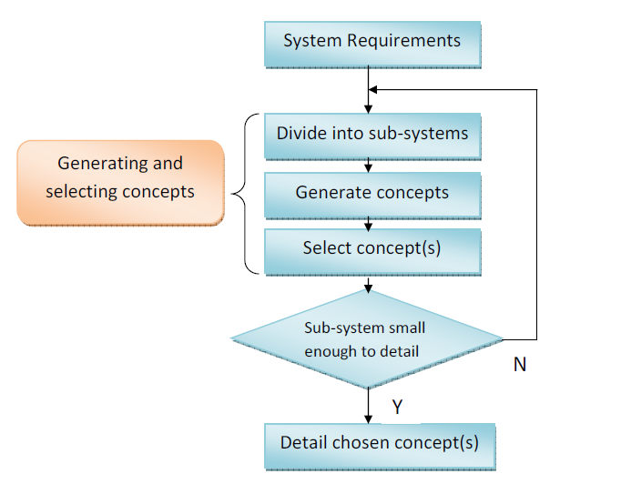
Functional
Design
Phase Flow

Slide 21
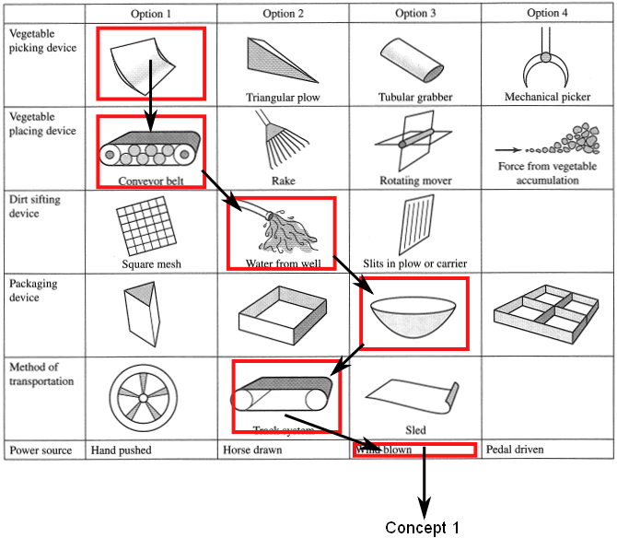
Morphological example
  Horizontal:
  Options
  Vertical:
  Items /
  functions /
  key parameters

Slide 22
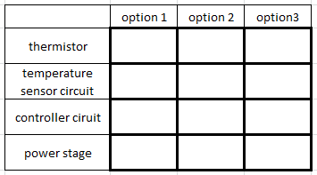
Morphological coffee maker
  Horizontal:
  Options
  Vertical:
  Items /
  functions /
  key parameters
  Make choices clear

Slide 23
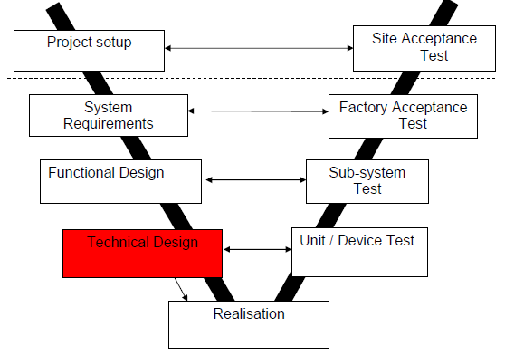
Technical Design
Detailed Electrical design
  Calculation / Simulation
  Temperature sensor
  Wheatstone
  Controller (Software block definition / flow chart)
  Power stage
Detailed Mechanical design
  Drawings of chassis is known
  Material is known

Slide 24
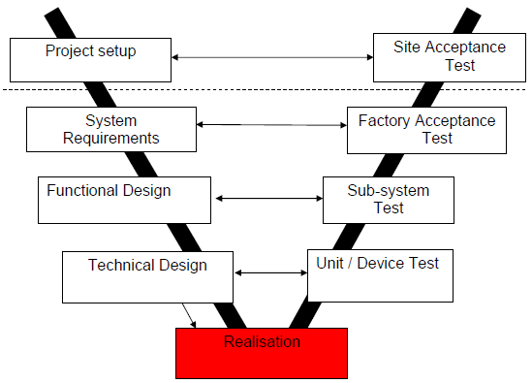
Realisation
Electrical-Electronic
  Making PCBs and unit assembling
Mechanical
  Making components and unit assembling
Software
  Unit coding

Slide 25
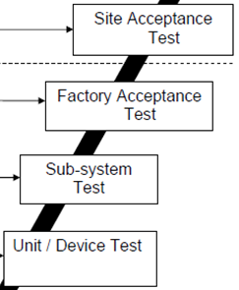
Testing
SAT: demonstration
for SAXION (client)
FAT: totally circuit test inside the machine
SST: totally circuit test outside the machine
UDT: circuit test by block

Slide 26
Deliverables
Project plan
Logbook
Agenda’s and minutes
Go/NoGo presentation
Final Report
Poster
Final presentation

